Slide 1
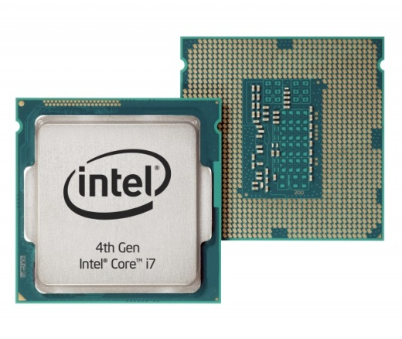
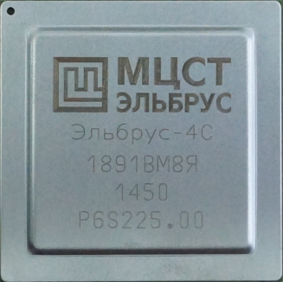
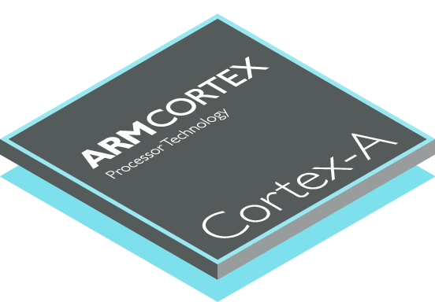
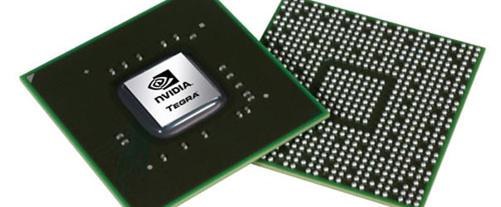
CPU production
Valerii Konychev, 211 group, MIPT
Moscow, 2016

Slide 2
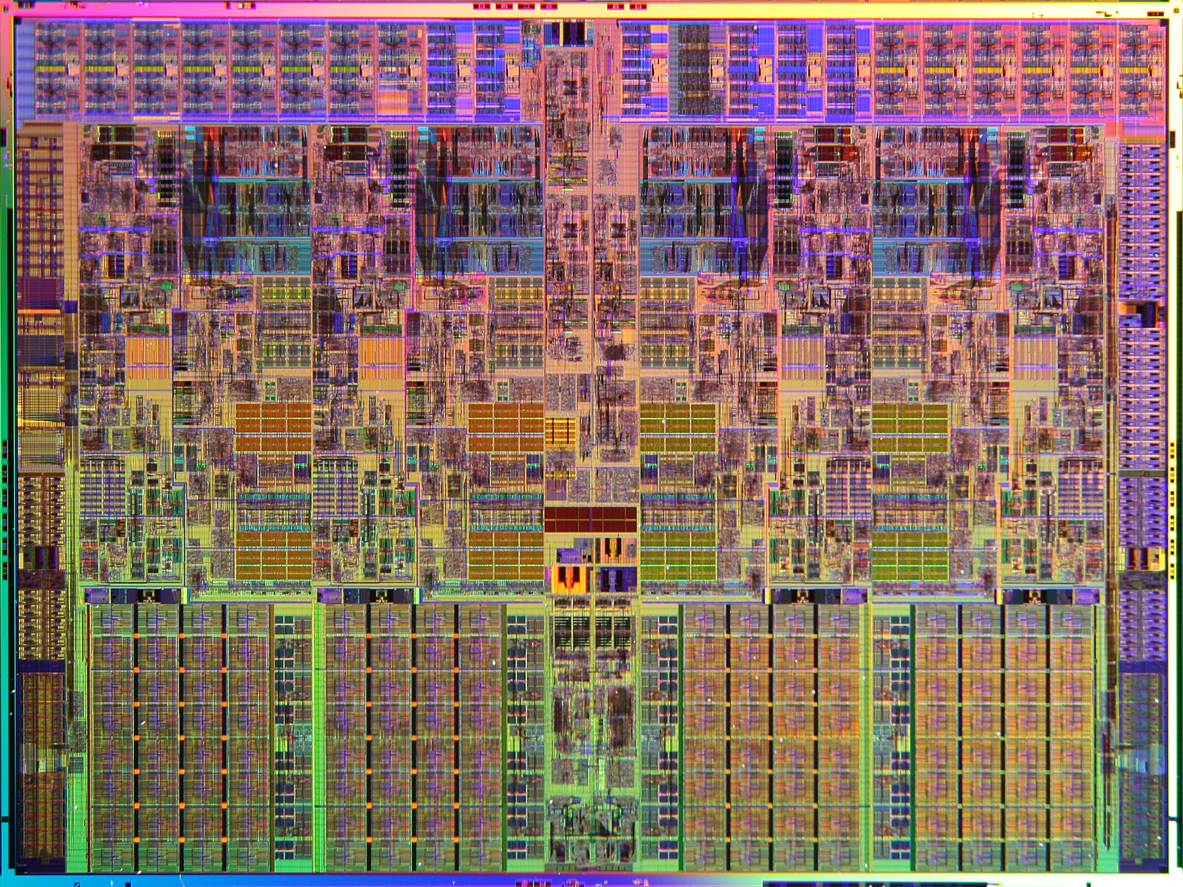

Slide 3
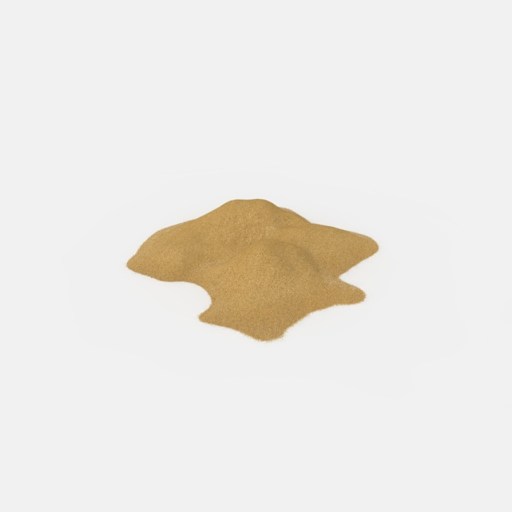
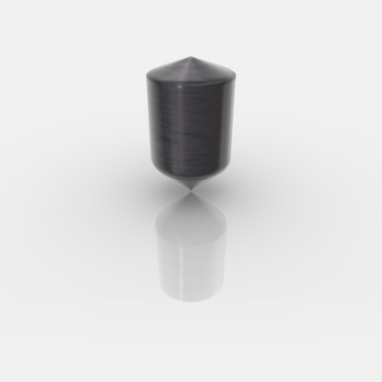
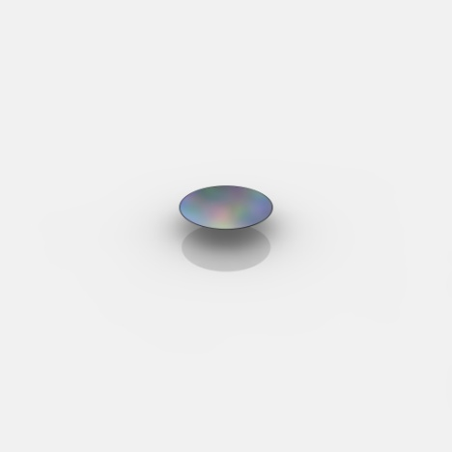
From sand to base
Sand:
With about 25%(mass) Silicon. (SiO2)
Ingot:
Silicon purity of 99.9999%
Wafer:
Radius ~300 mm
Thickness ~1 mm

Slide 4
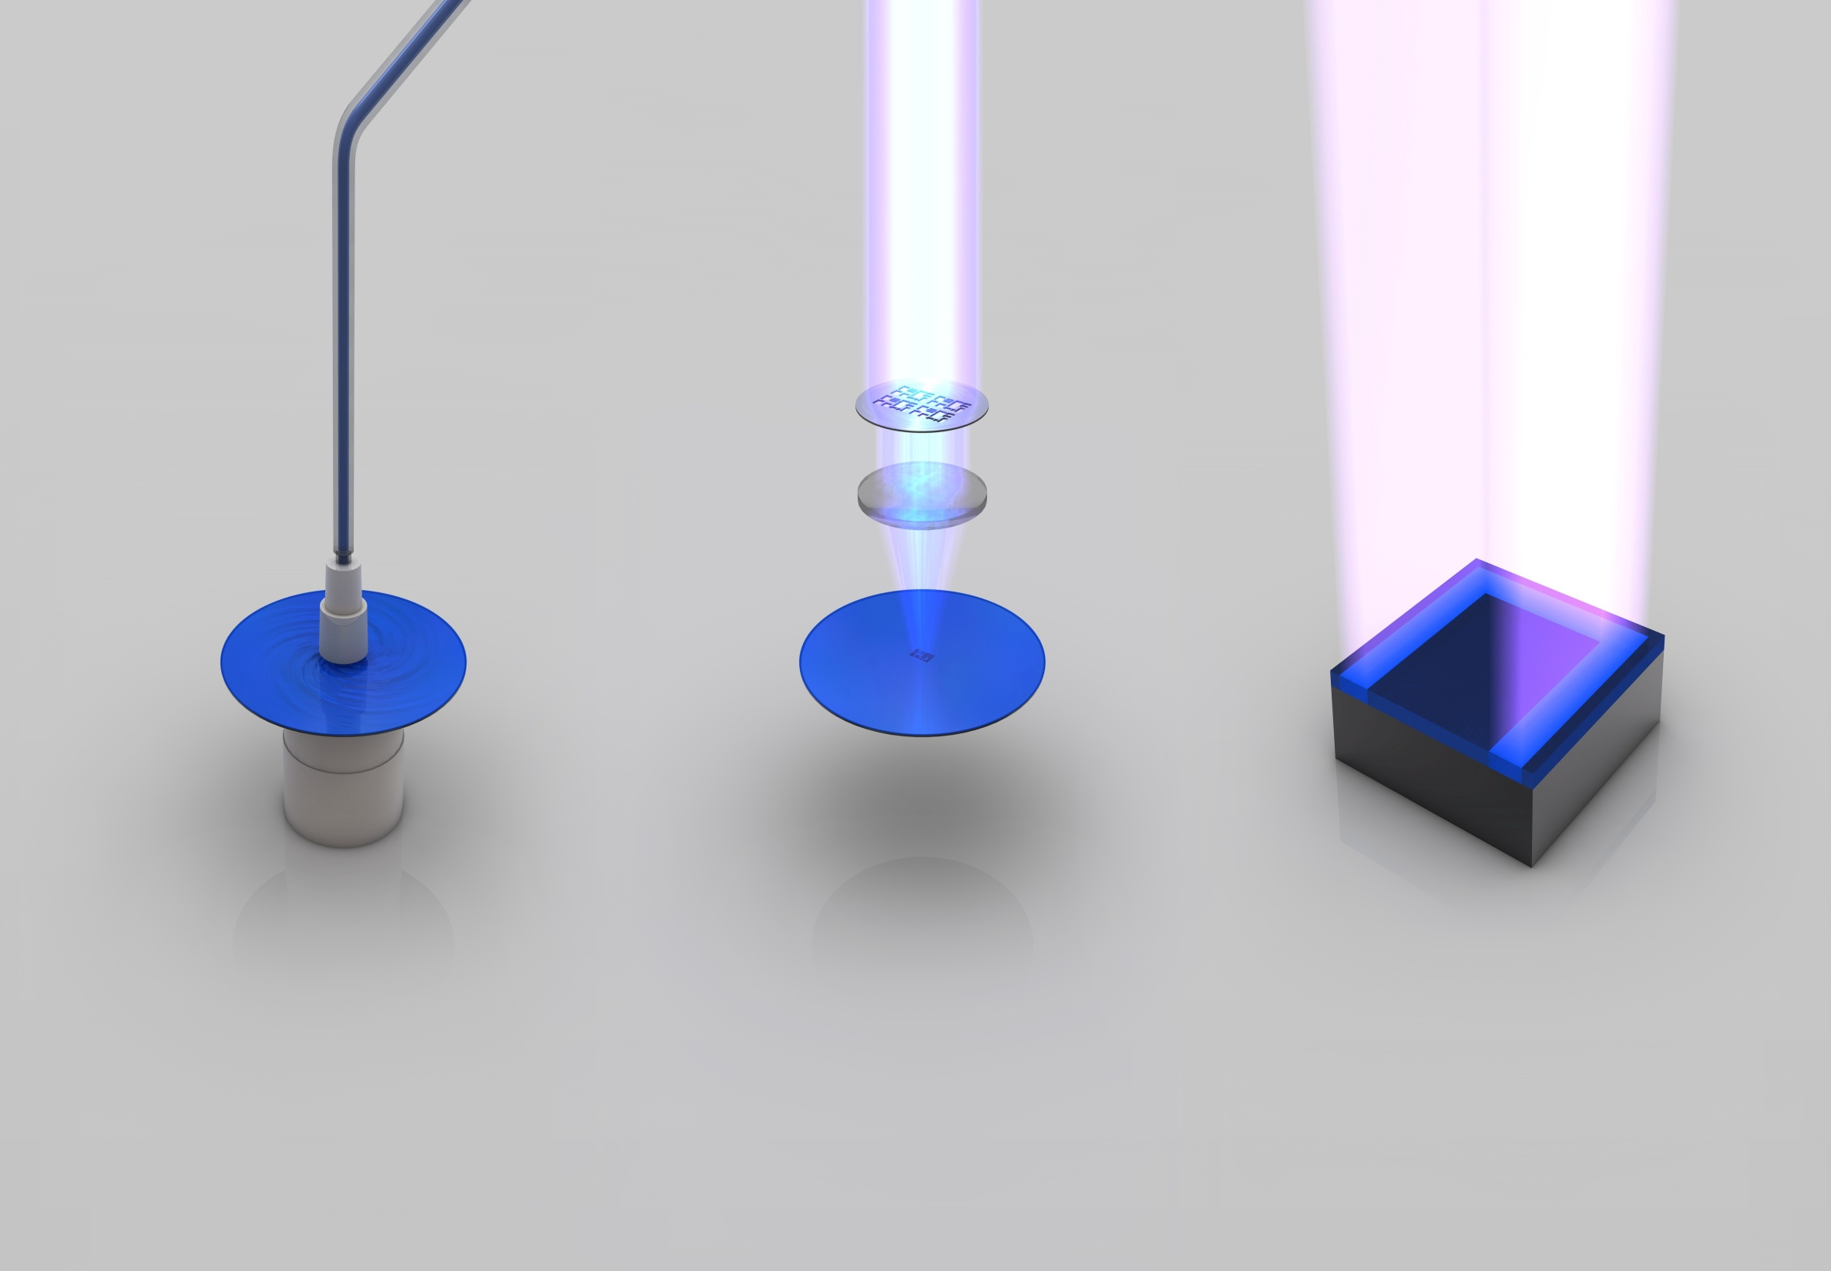
Photo lithography
Applying photo resist
Exposure of ultraviolet light :
Become soluble

Slide 5
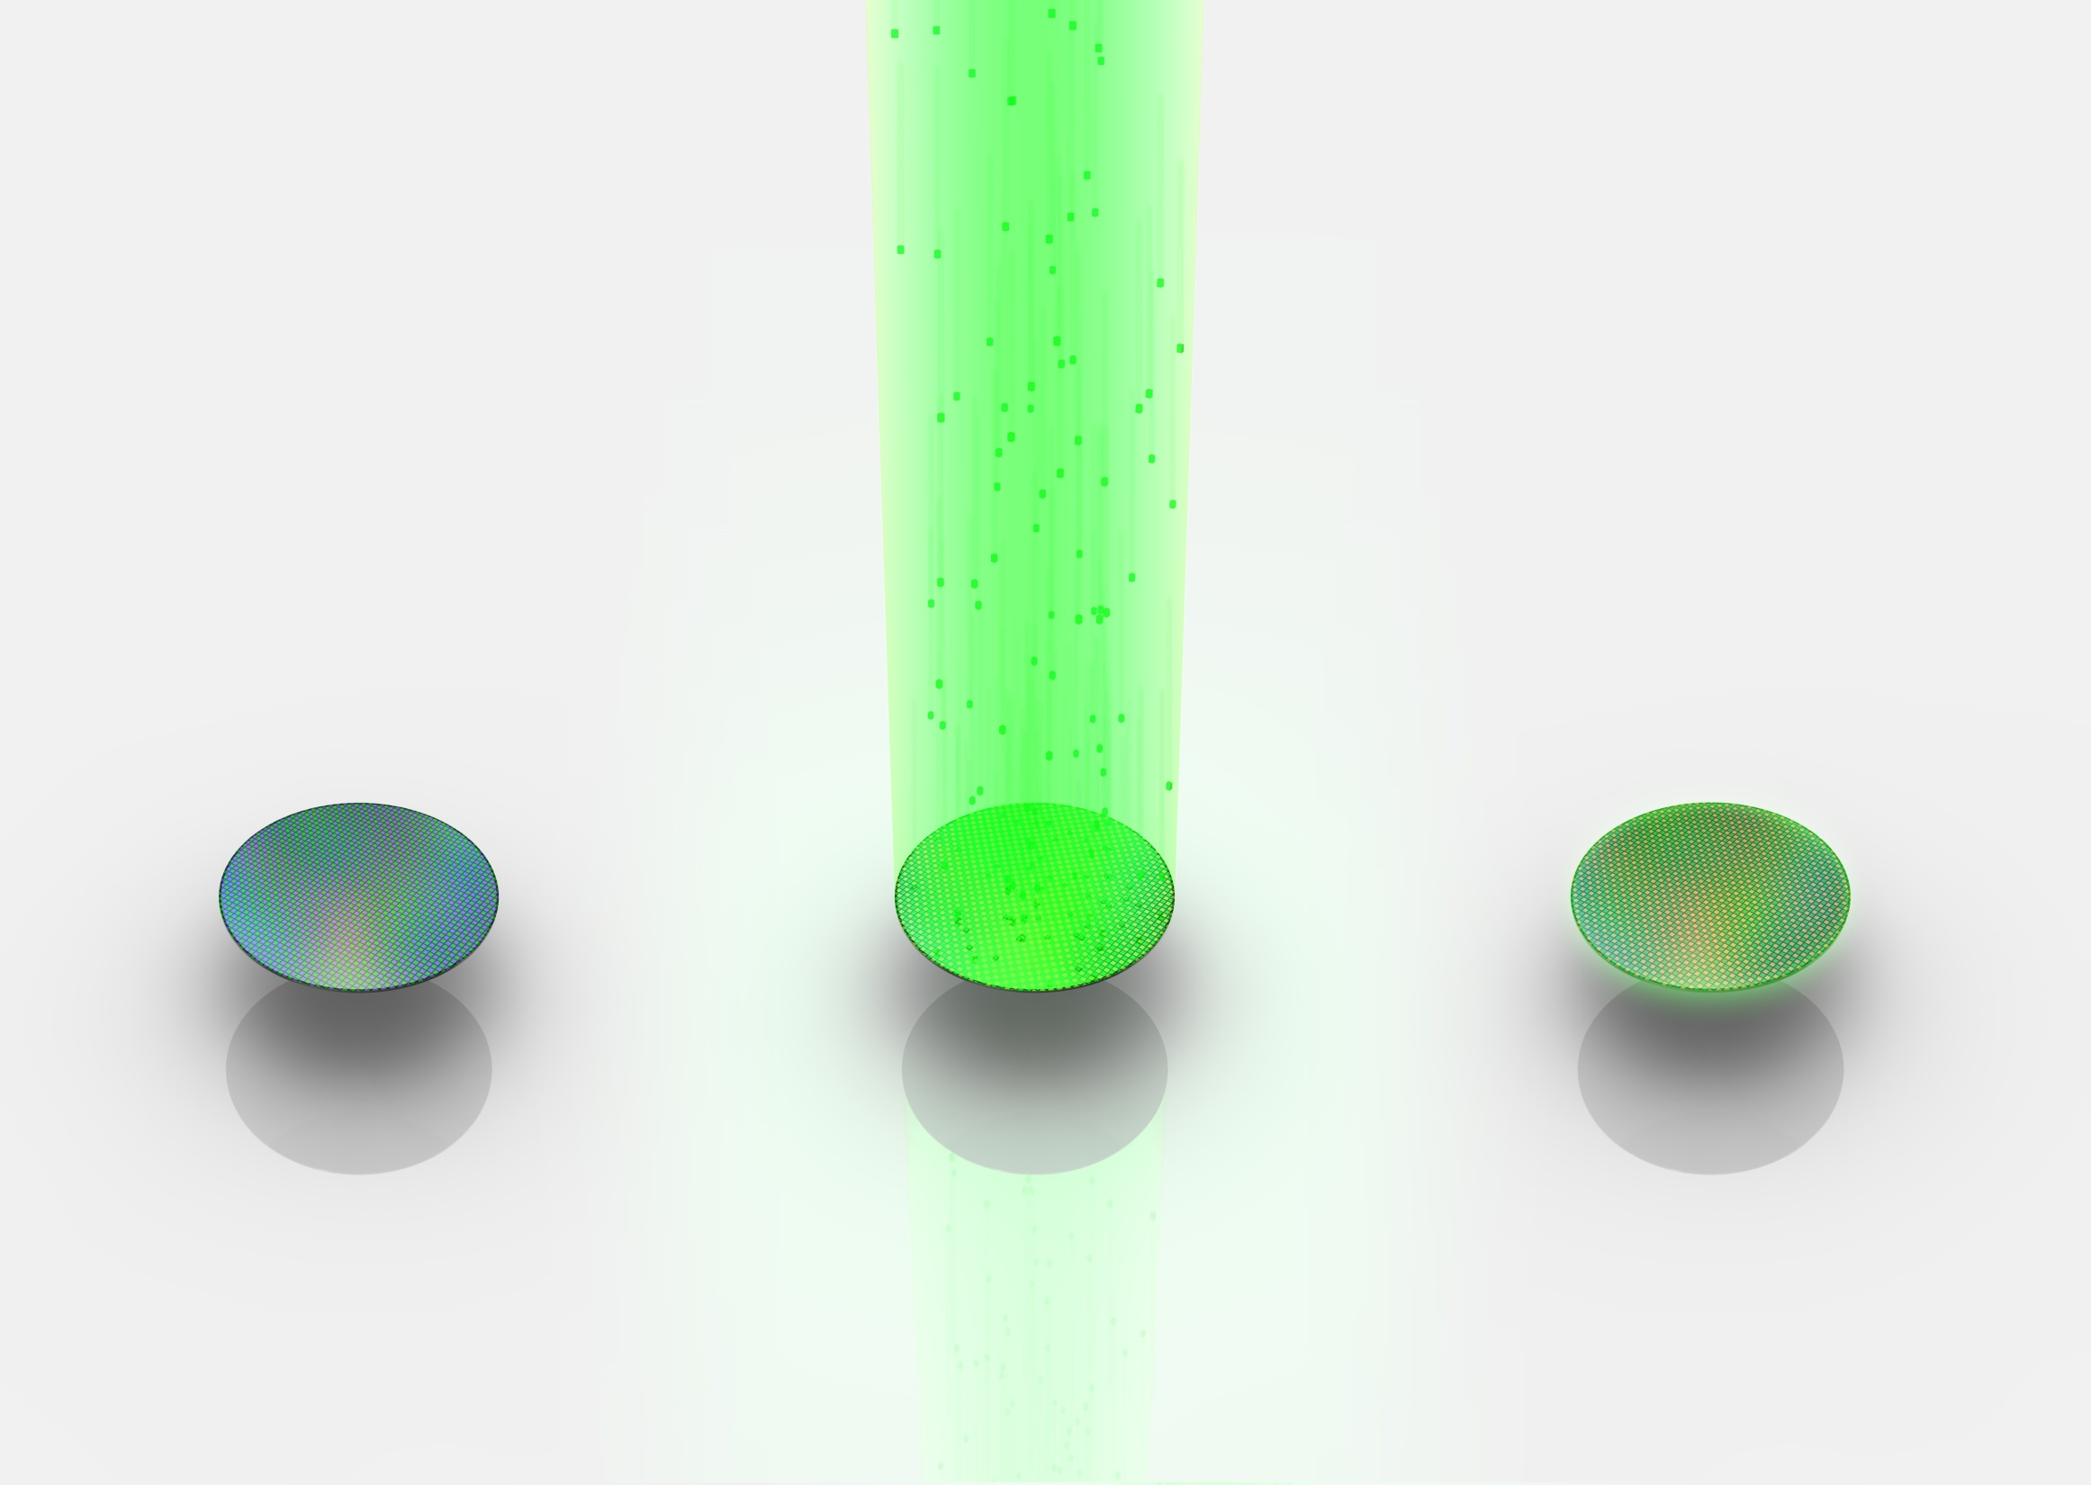
Ion implantation
Ion implantation:
Beams of ions(positive or negative)
Removing photo resist

Slide 6
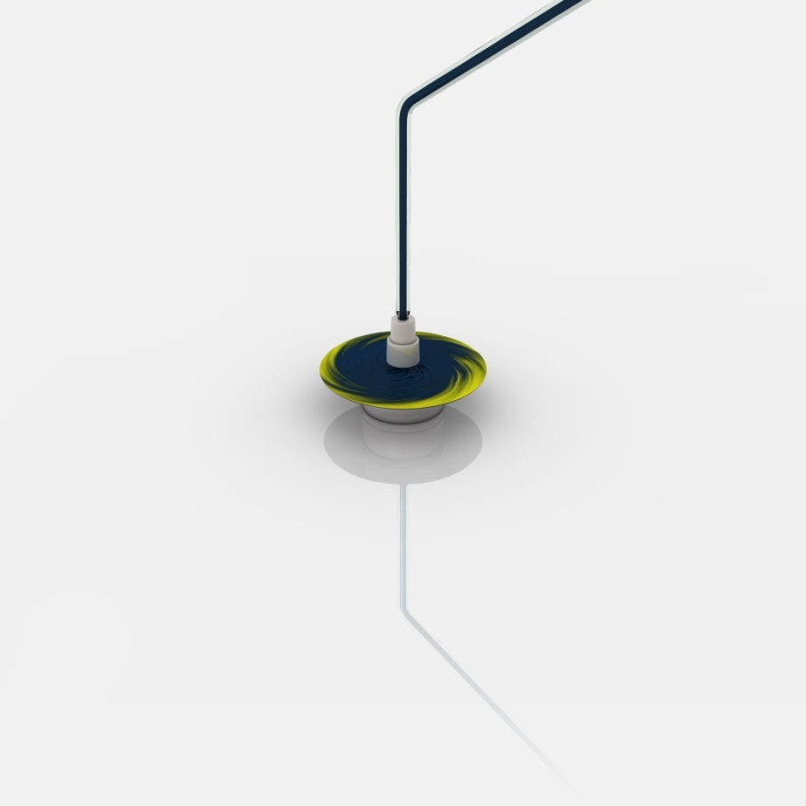
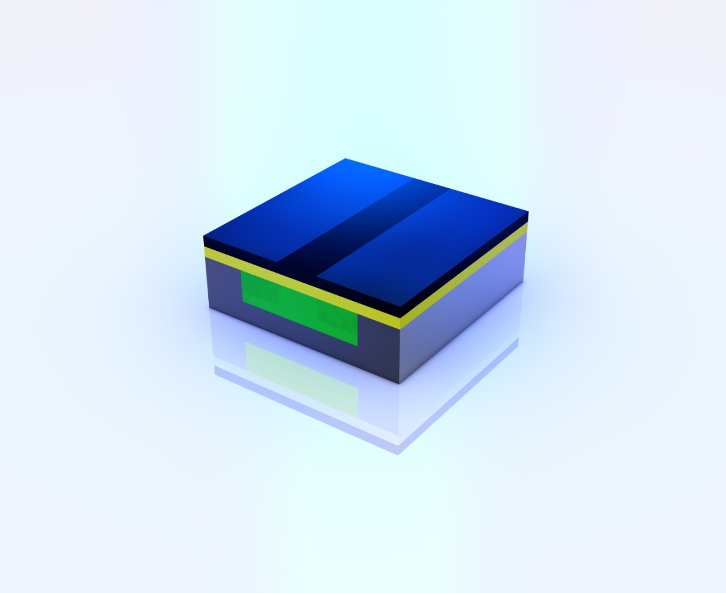
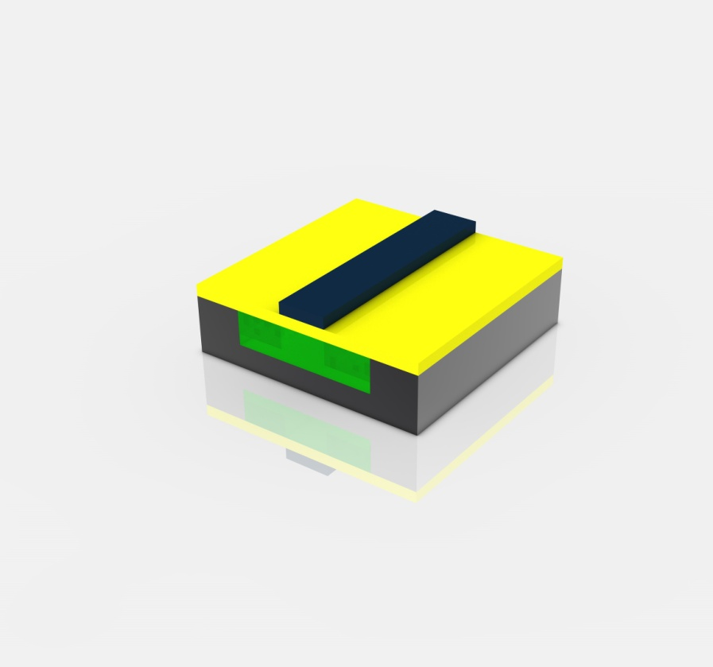
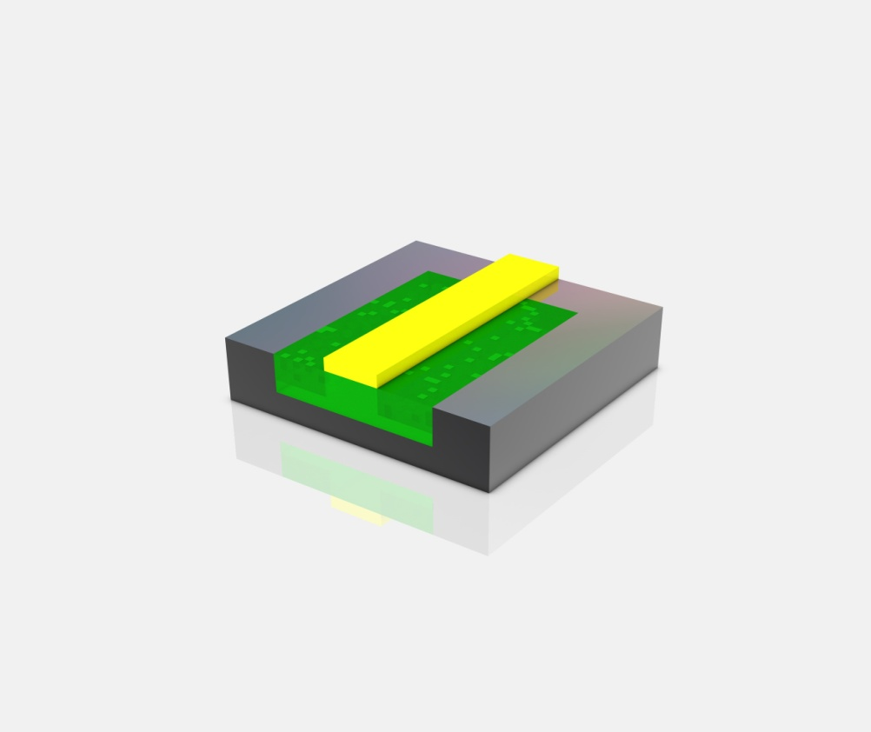
Etching
Applying dielectric and photo resist
Etching: chemicals

Slide 7
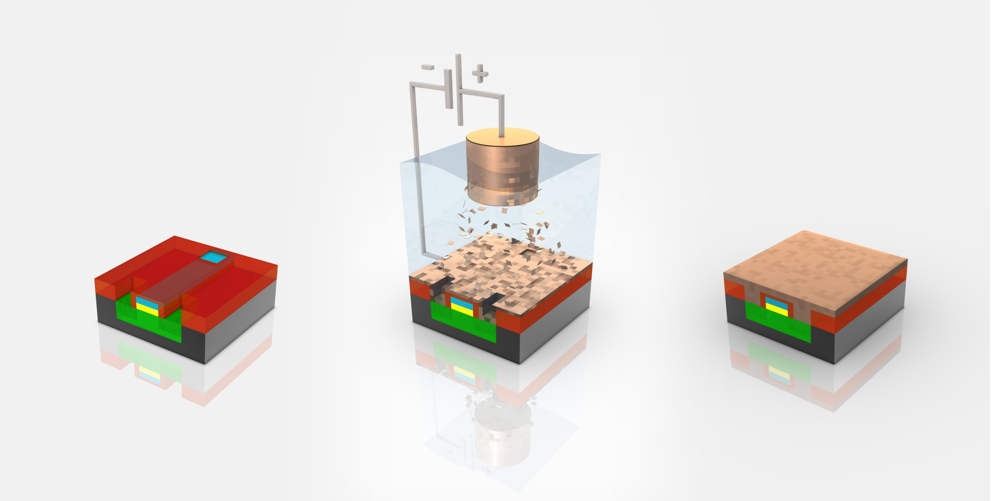
Metal Deposition
Depositing copper: electroplating
Blue layer: metal Red layer: insulation

Slide 8
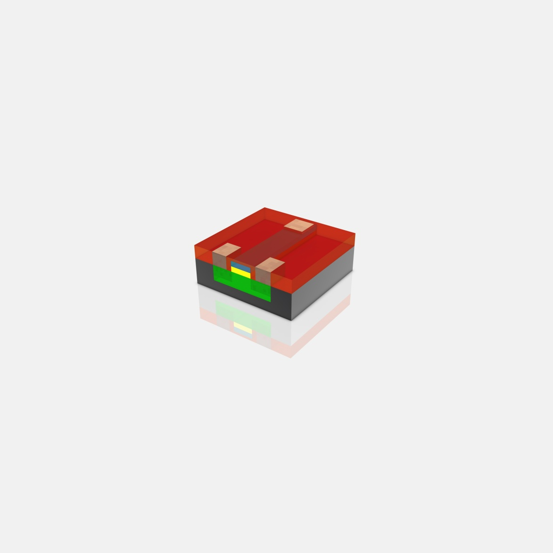
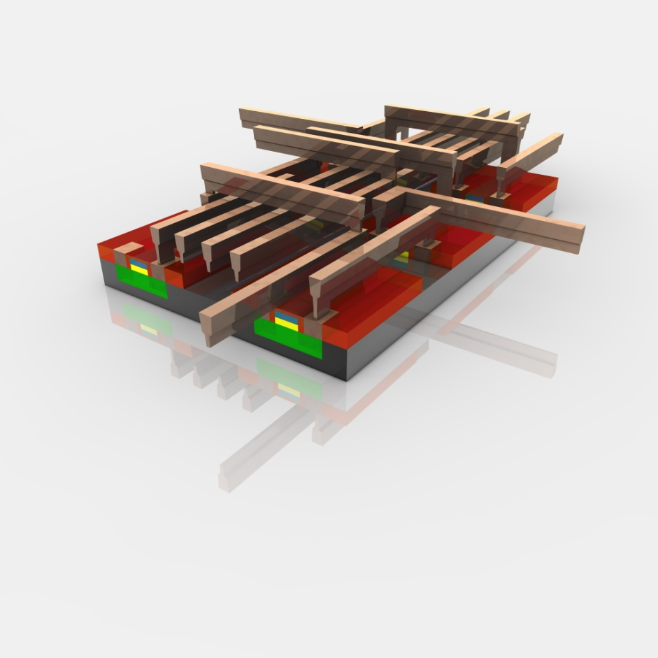
Metal Layers
Polishing
Metal Layers

Slide 9
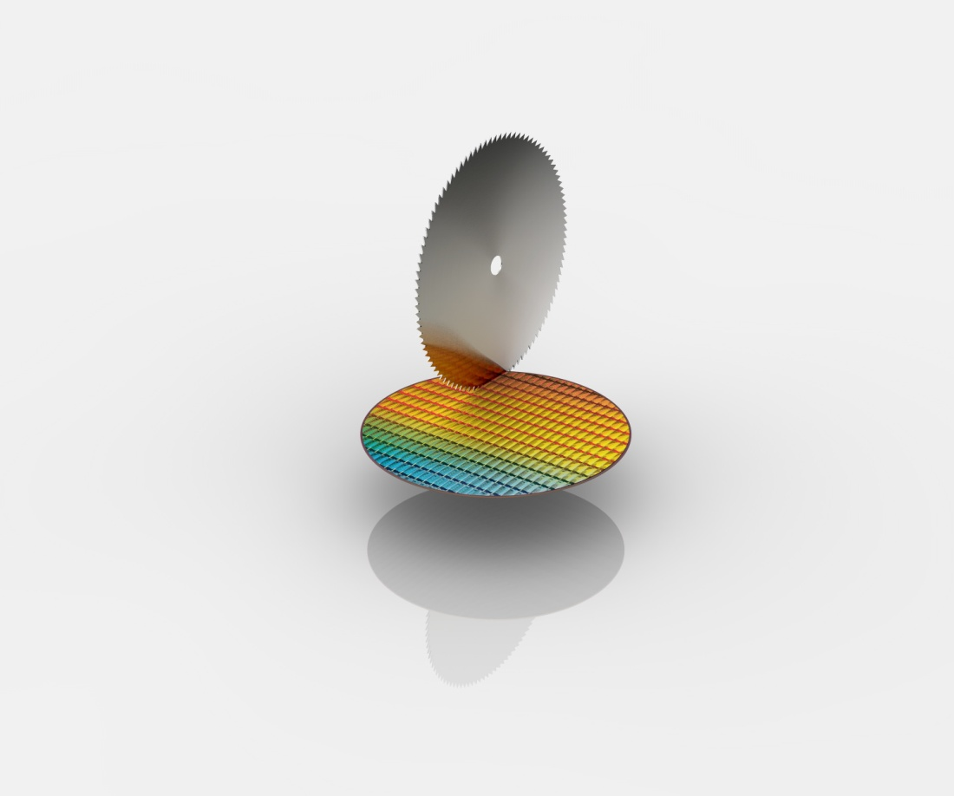
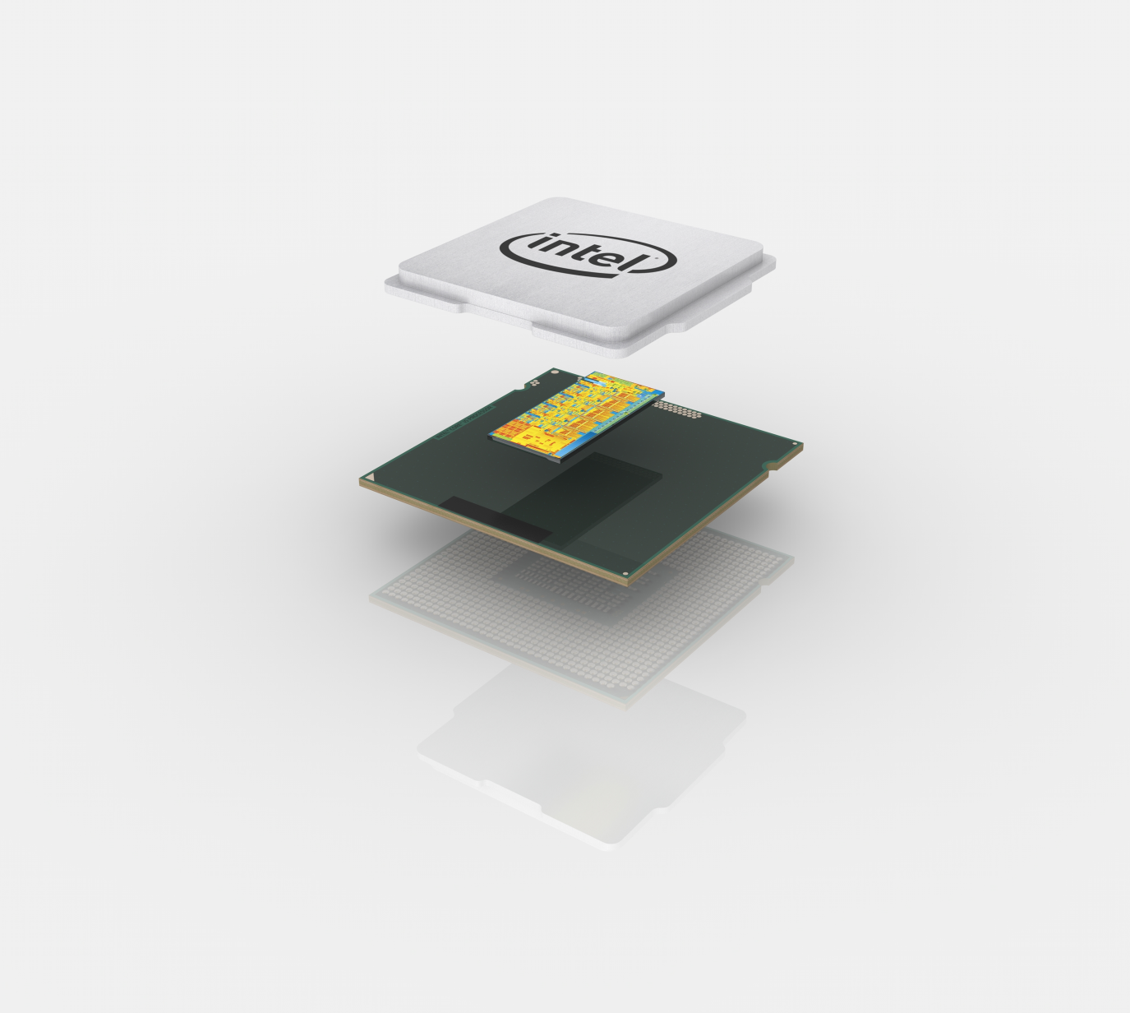
Final
Packaging
Slicing

Slide 10
Summarize
CPU production
Ingot
Wafer
Photo lithography
Ion Implantation

Slide 11
Thank you for your attention

